Slide 1
ECE Green Team Final
QUAD (Quick UAV-Attacking Drone)

Slide 2
Project Overview

Slide 3
Project Objective
Design and build an unmanned aerial vehicle (UAV) robocopter that performs autonomous detection, tracking, and pursuit of multiple target UAVs.

Slide 4
Client Requirements
Requirements
UAV with maximum size of 4’x4’x4’
Minimum of one sensory modality
Autonomous flight and control
Autonomous obstacle avoidance
Protective cage
Wireless stream to ground station
Video symbology
Modes: Search, Pursue, Reset, Repair
Goals
10-minute flight time
Low-latency video stream
Cost-effective
Modular design
Resistant to environmental changes

Slide 5
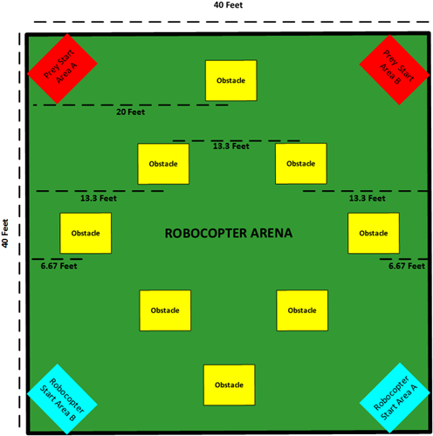
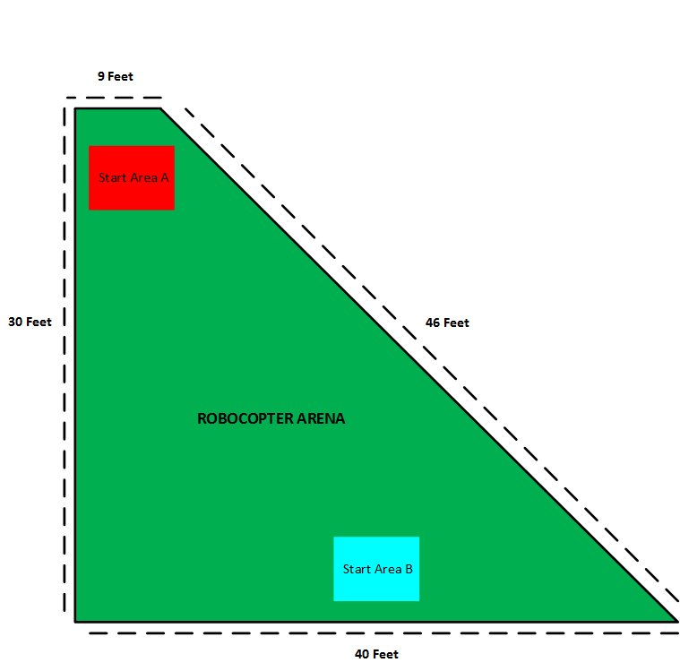
Competition Changes
Area 1: 1600ft²
Area 2: 870ft²
Notes:
Reduced competition arena size
Expected total impulse reduced by 17%
Longer estimated TOF
Removed obstacles

Slide 6
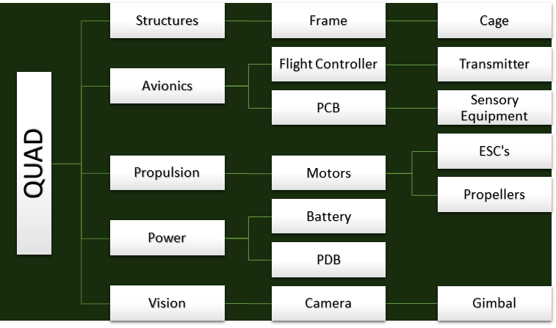
Component Decomposition

Slide 7
Structures

Slide 8
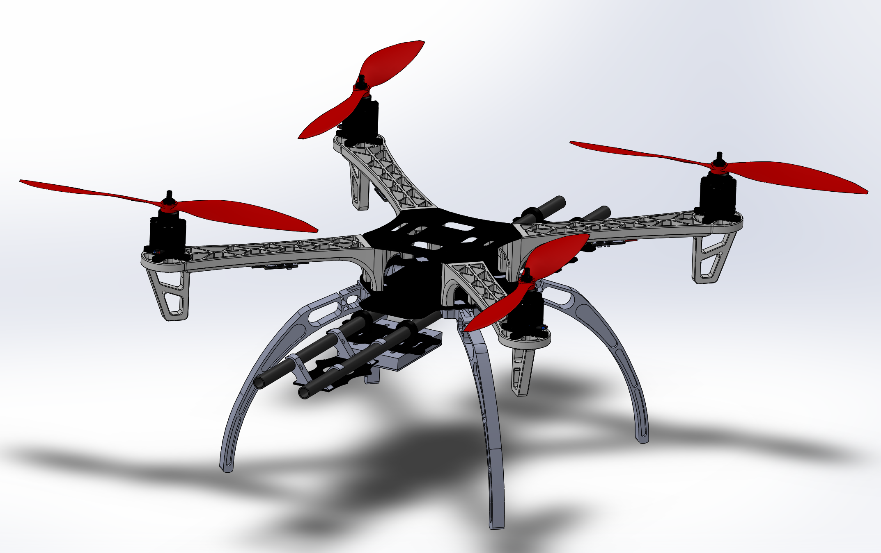
Drone Mechanics
Components
DJI F450 Frame
30A ESC
Sunnysky 2216 motors with 800 KV
1047 propellers
Camera Positioning Kit
Notes:
New Propellers Gives much better efficiency for acceptable drop in maximum thrust

Slide 9
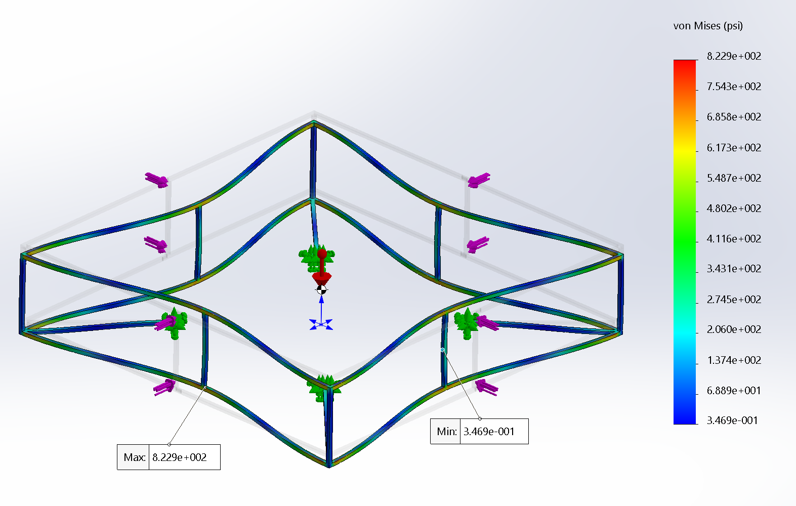
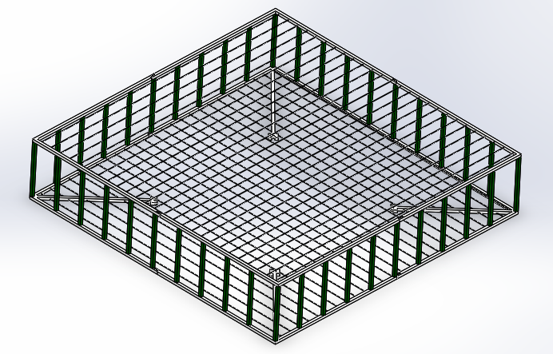
Cage Design
Notes:
0.25” ABS plastic material.
Use of CNC router to assist in cage manufacture.
0.116” threaded nylon rods with nylon nuts to connect the top and bottom of cage together.
Issues we ran into
Induced vibration creates oscillation
Oscillation exceeds what is allowable for stable flight
Potential Solutions
Reinforce cage supports with tape
Additional connection points

Slide 10
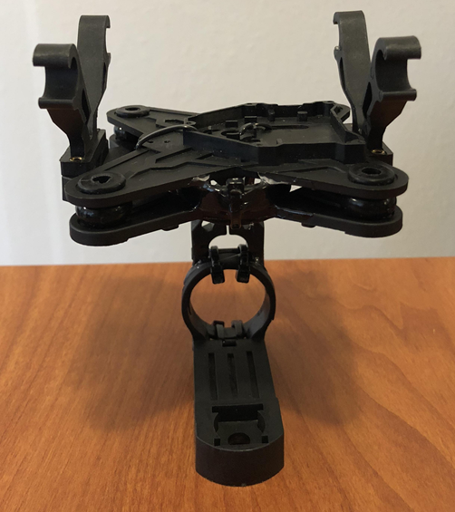
Camera Mount
Inability to integrate and assemble gimbal created need for camera mount
Used parts from QWinOut 3-axle gimbal
Zip-tied and epoxied connected parts
Dampers used for dissipating vibration which affects camera

Slide 12
Avionics

Slide 13
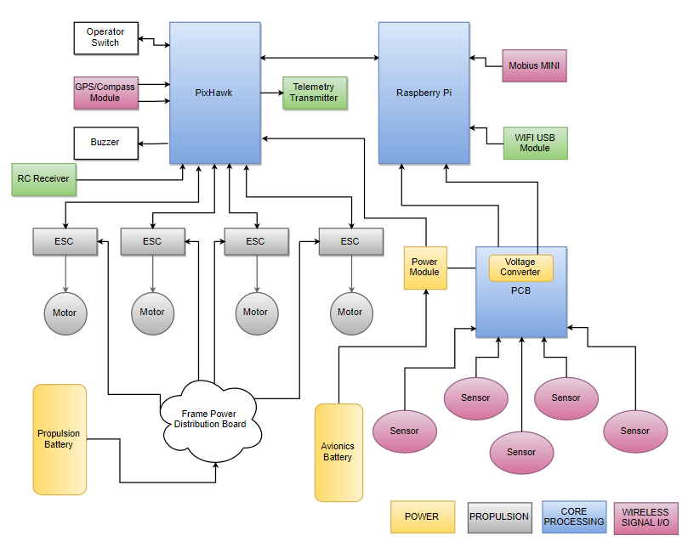
Hardware Diagram

Slide 14
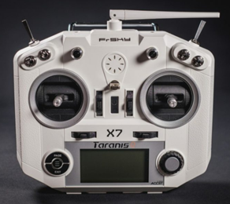
Manual Control - Transmitter
FrSky Taranis 7X transmitter
2.4GHz 16-channel Transmitter
GUI to assign channels for quadcopter control functions (Rudder, Throttle, Elevation, Alerion)
Frequency switching for minimal noise interference
FrSky Taranis 7X Transmitter

Slide 15
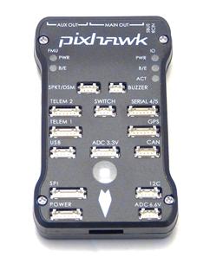
Flight Controller
Decision Criteria:
Commercially available
Provides core flight control features
Highly customizable (preferably open-source hardware/software)
Support for remote-controlled and closed-loop guidance
Compatibility with onboard processing computer
MAVLink communication protocol support
Pixhawk 2.4.8

Slide 16
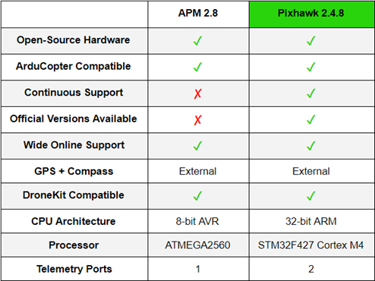
Flight Controller Specifications
APM vs PixHawk Comparison

Slide 17
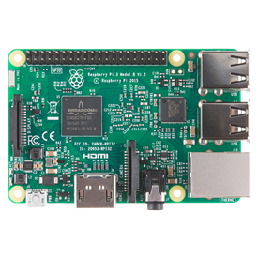
Onboard Computer
Decision Criteria:
Processing power for image processing, path planning, and decision making
Software compatibility
MAVLink support for communication with controller
Low latency for real-time processing
Wireless capabilities for video transmission
Raspberry Pi 3B

Slide 18
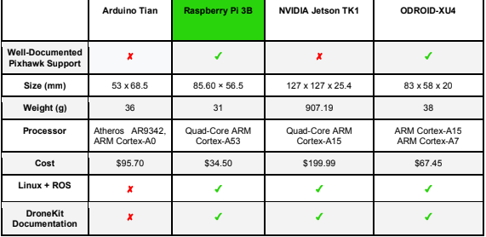
Onboard Computer Specifications

Slide 19
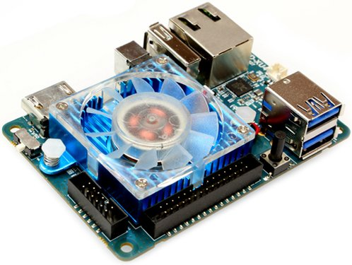
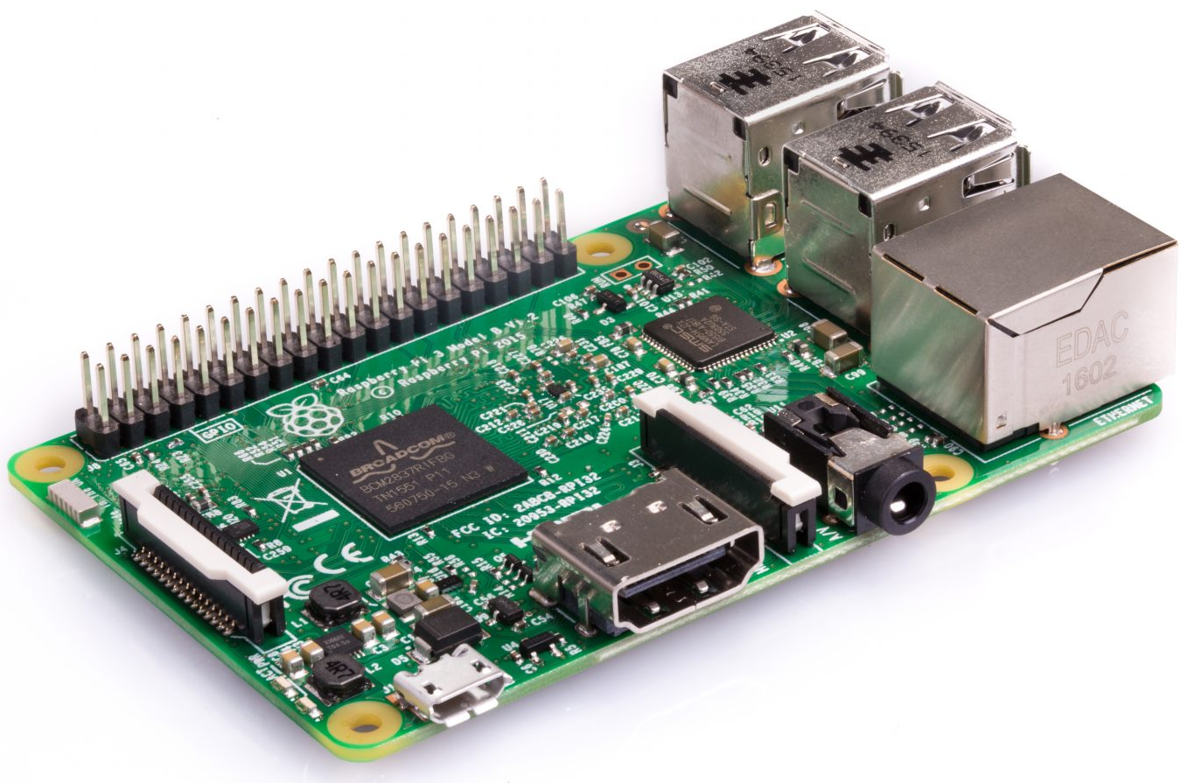
Onboard Computer Changes
Initially chose Raspberry Pi 3
Switched to odroid, switched back
ODROID Benefits
Processing power and speed
More RAM
Less weight
Vision algorithms worked better on the Pi than the ODROID
ODRIOD-XU4Q
Raspberry Pi 3

Slide 20
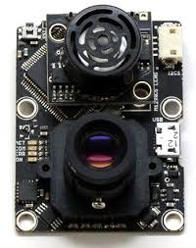
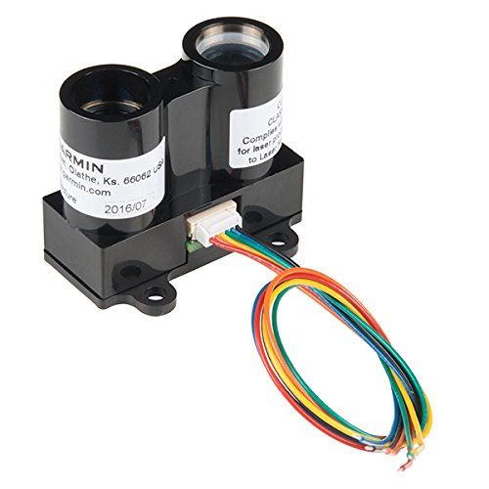
Navigation Sensors
Need for additional sensors to allow for flight in indoor or GPS-inhibited venues
PX4FLOW - Optical Flow Sensor
XY Movement
LIDAR LiteV3 - RangeFinder
Z Movement (Altitude)
Work well but are easily uncalibrated
PX4FLOW
LIDAR LiteV3

Slide 21
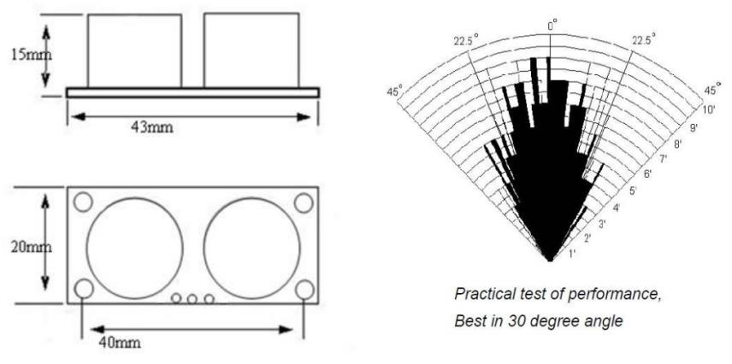
Proximity Sensors
Cost effective and reliable
Relatively small, allowing multiple sensors
Used for wall detection to avoid fatal collisions
Large field of view per sensor (approx 30 degrees)
Distance range: 20mm - 5m
HC-SR04 Ultrasonic Sensor Performance

Slide 22
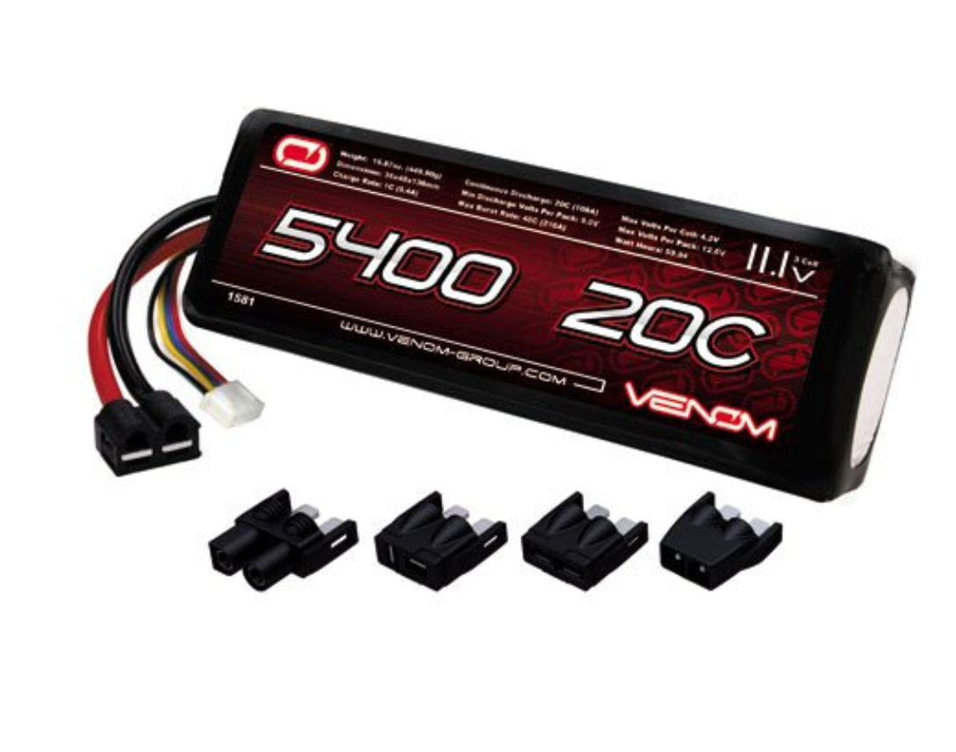
Primary Battery
Four motors draw a maximum of 23 amps for a total of 92 amps
Producing an average thrust of 3300 grams requires about 44 A. Over ten minutes this requires around 7300 mAh
To keep mass down it was decided to replace the battery at roughly the 5 minute mark
Battery chosen was a Venom 5400 mAh 3S battery with a 20C rating and only 390 grams able to provide

Slide 23
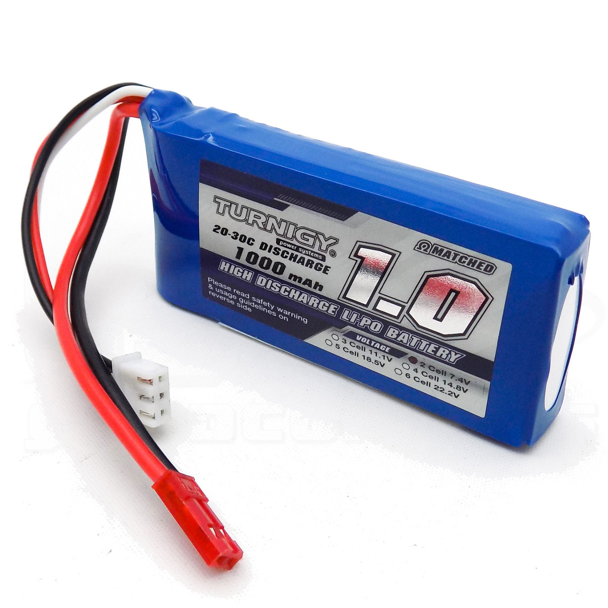
Secondary Battery
To avoid “brownout” caused by high amp draw from motors, the flight controller, MCU, sensors, and companion computer is powered from secondary battery
Turnigy 1000mAh 2S 20C LiPo is able to easily provide enough power to all electronics for the full 10 minutes
Fairly lightweight at 82 grams

Slide 24
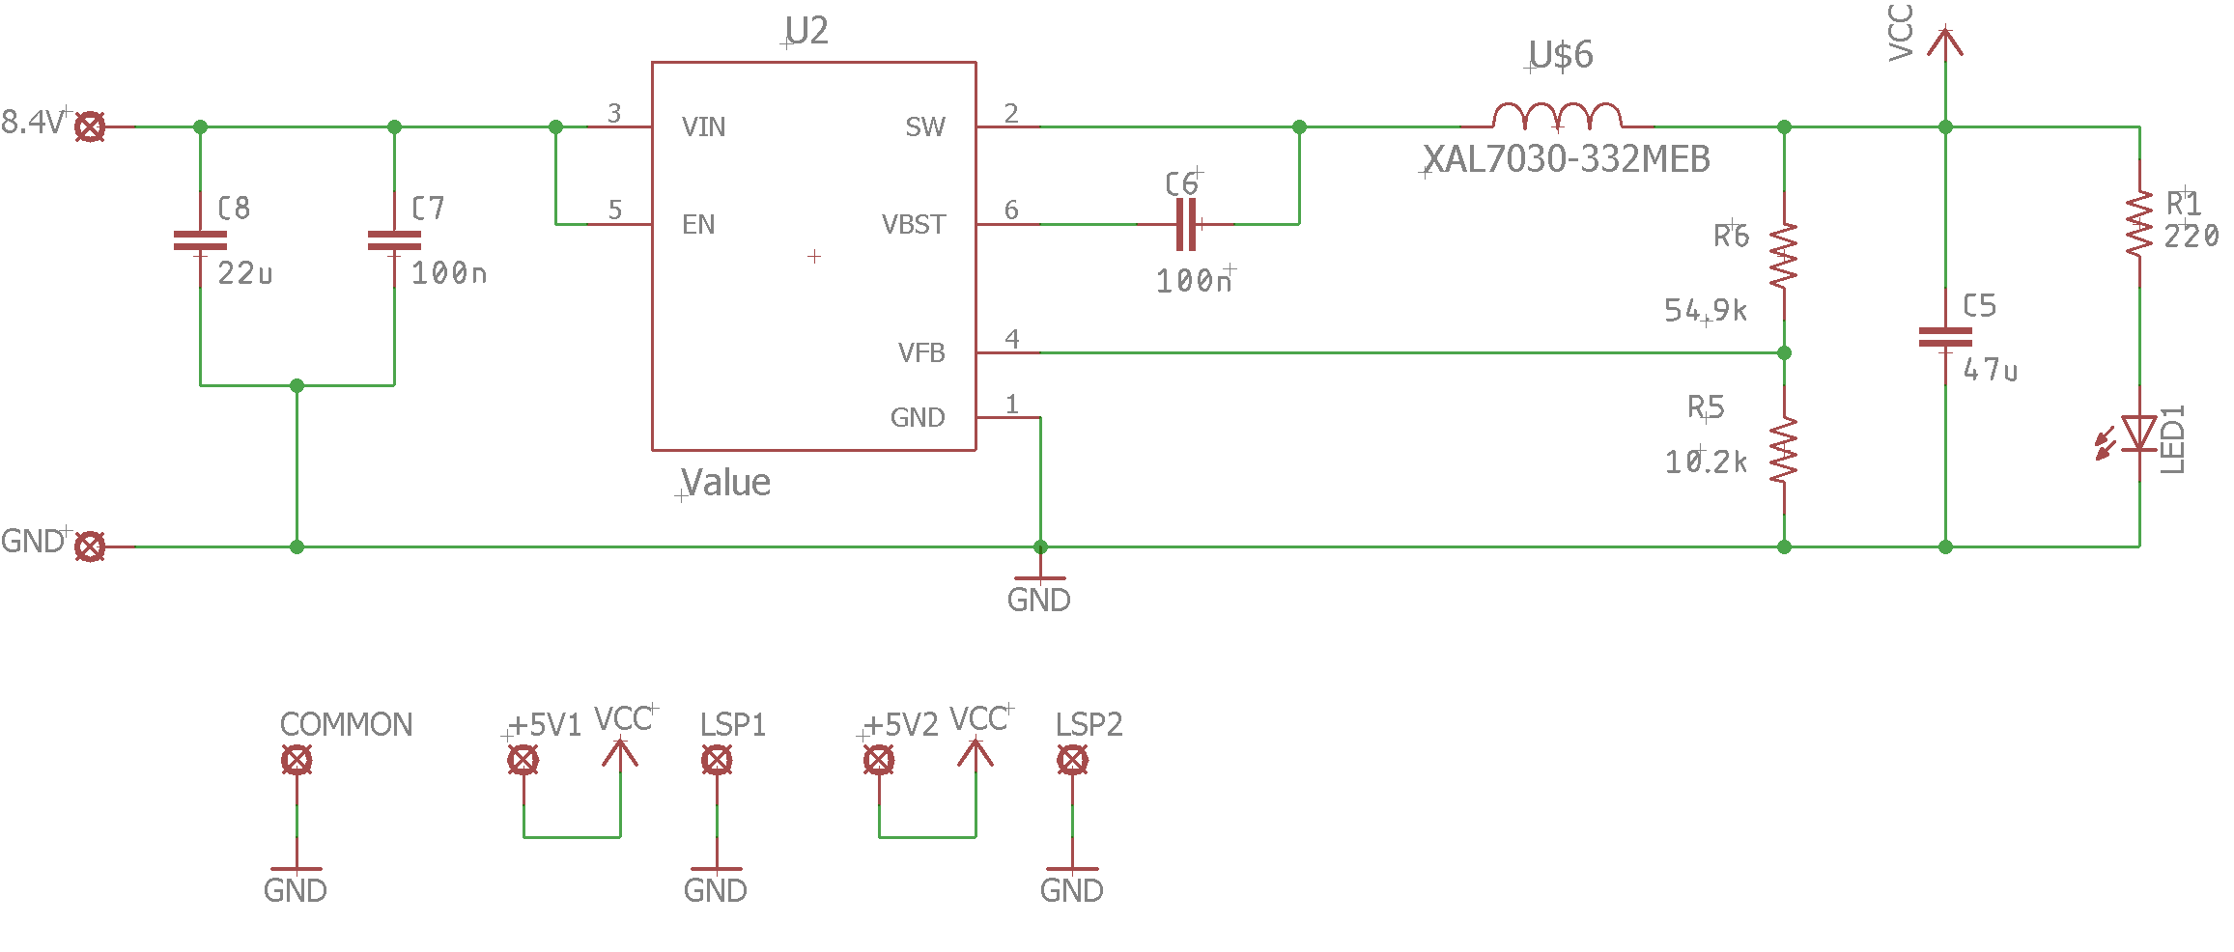
Voltage Conversion

Slide 25
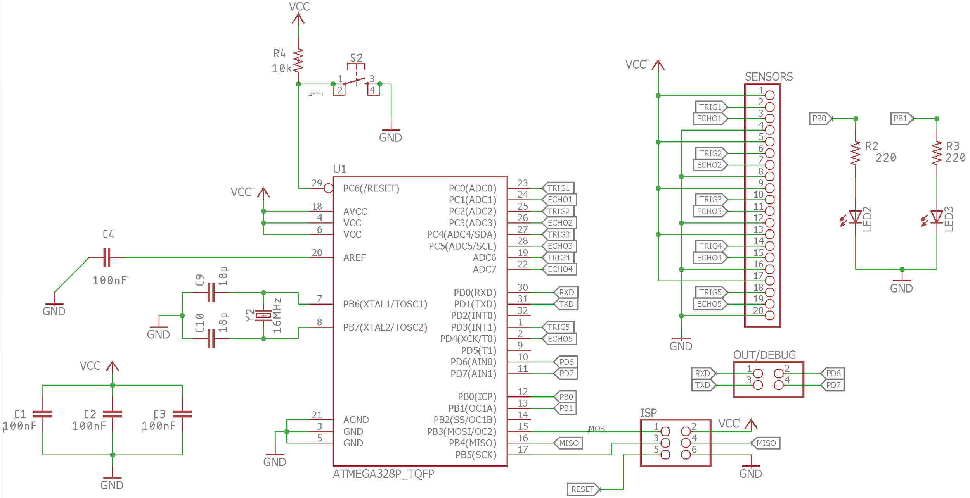
MCU

Slide 26
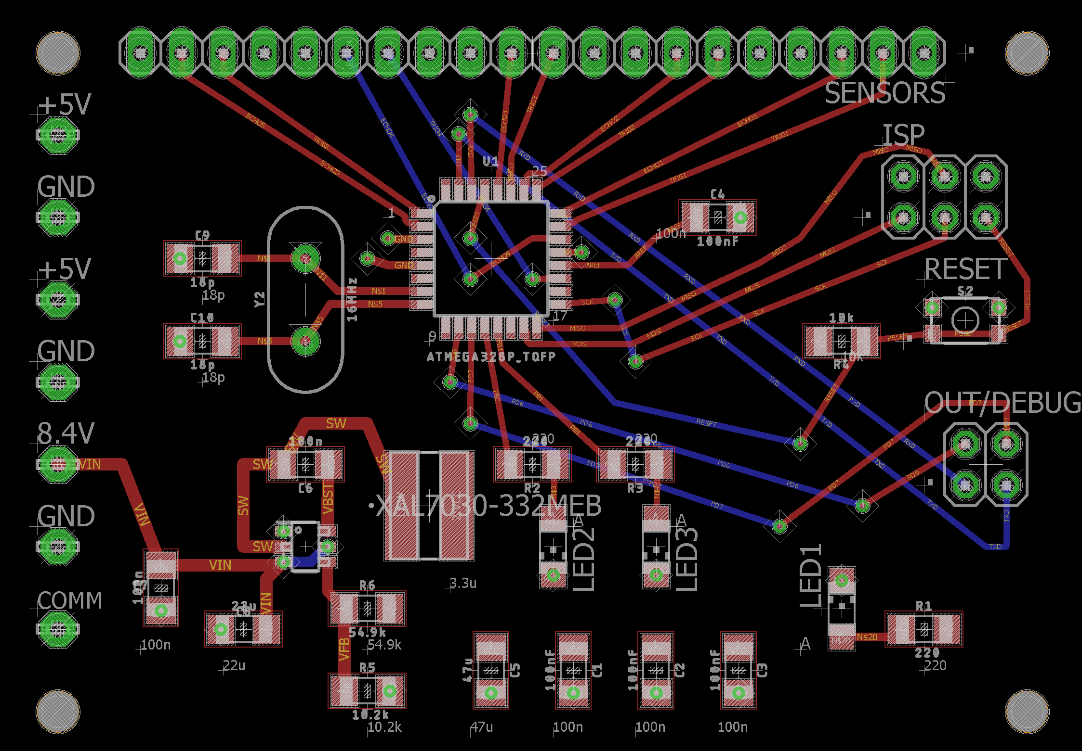
Board View

Slide 27
PCB Finalization

Slide 28
Software

Slide 29
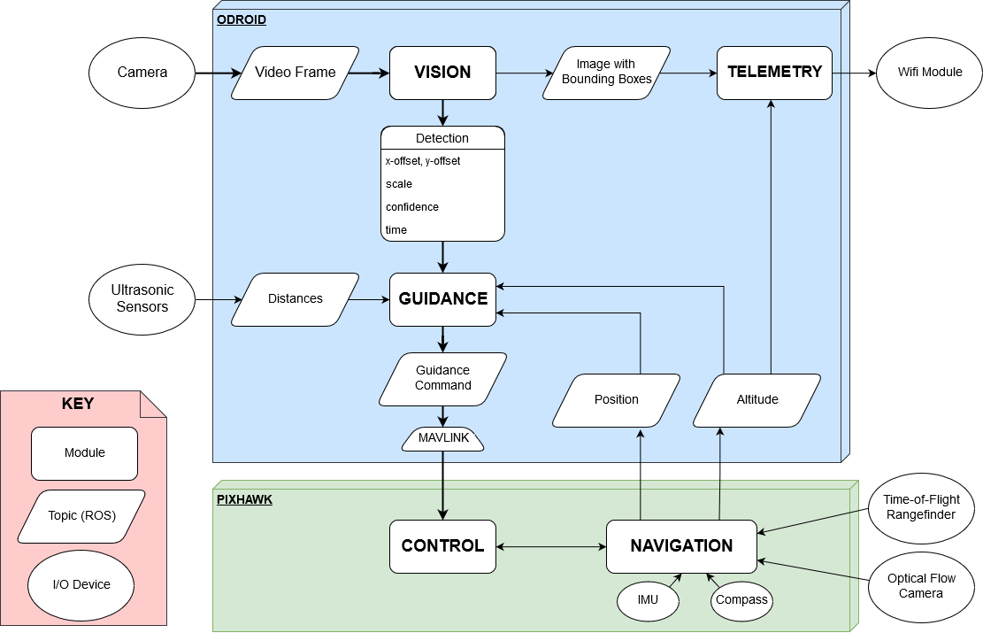

Slide 30
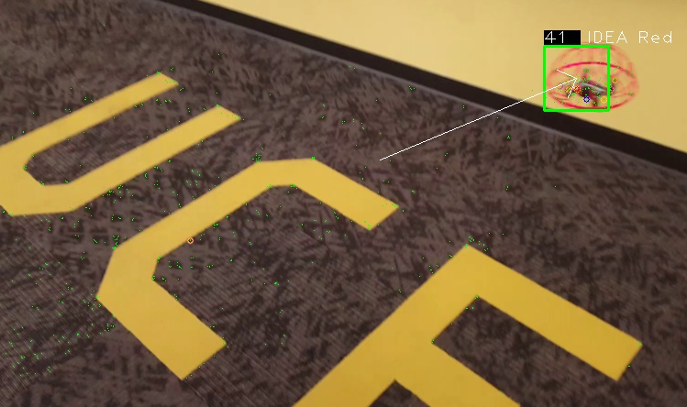
Vision
Input: Video feed
Output: Bounding box around target
Use detection information for guidance
Transmit detection image to GS
Requirements:
Real-time speed
Must react quickly
Limited processing power
High accuracy
Precision, recall

Slide 31
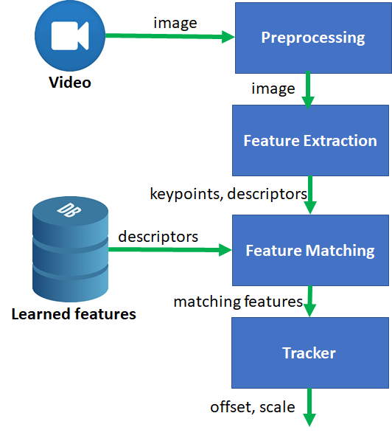
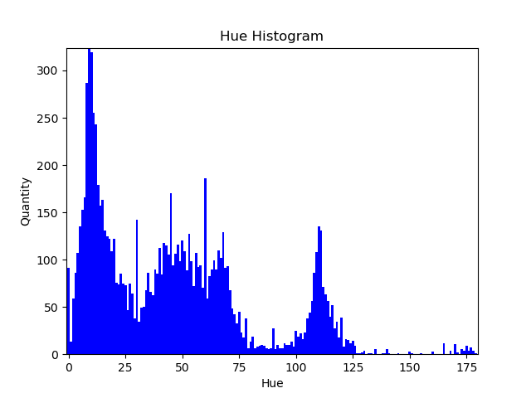
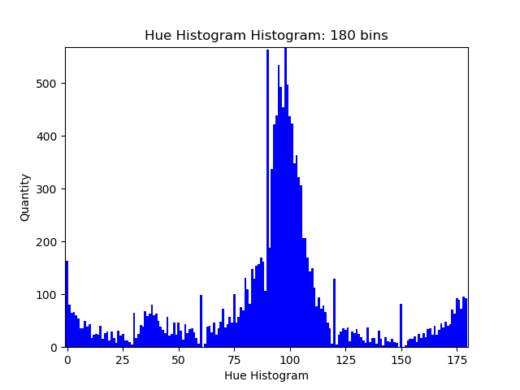
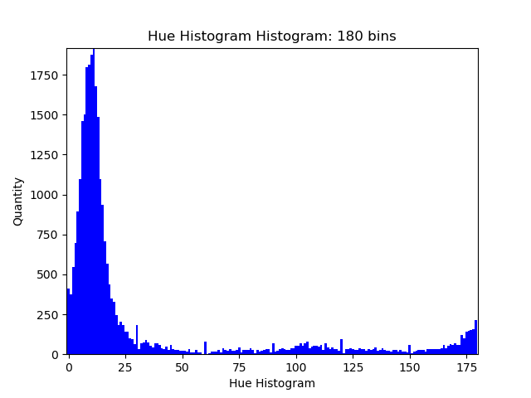
Detection
Detect image features (keypoints)
“ORB: an efficient alternative to SIFT or SURF", 2011
Match to learned features of target objects
Weight keypoints by color
HSV color space ranges
2 ranges per UAV
See hue histograms of different objects below
Fit bounding box around object
Window with greatest sum of keypoint weights
Candidate window centers: colored keypoints
Track object keypoints between frames
Optical flow on keypoints

Slide 32
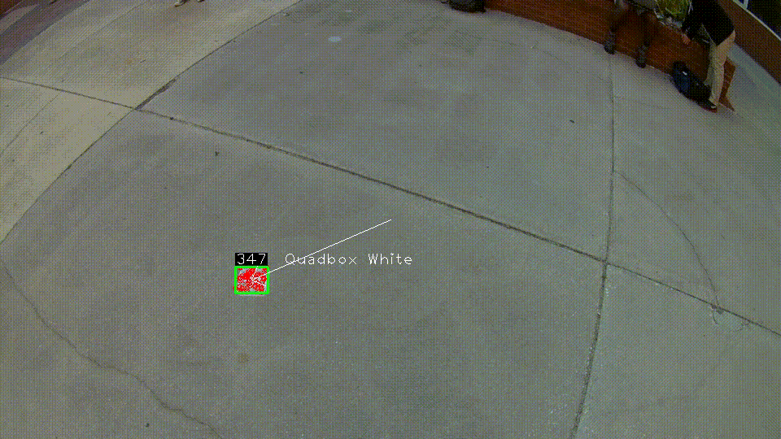
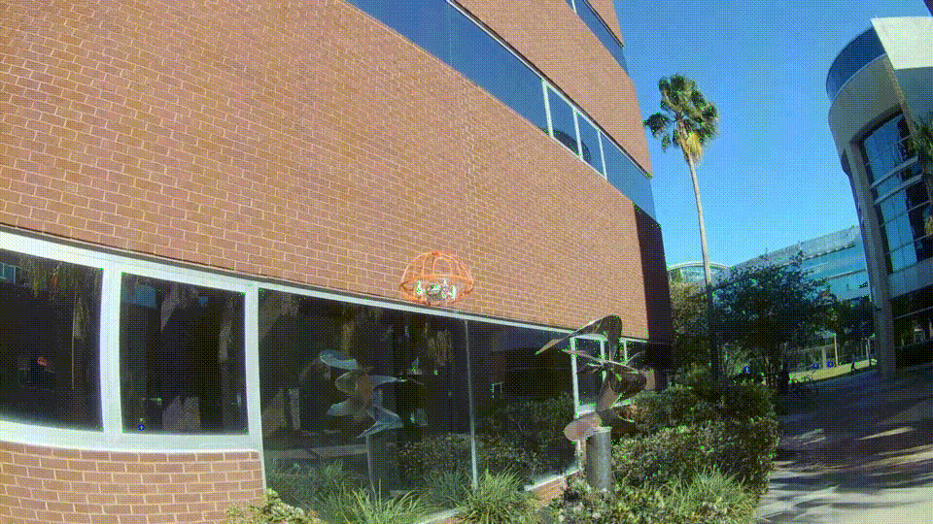
Vision Demo

Slide 33
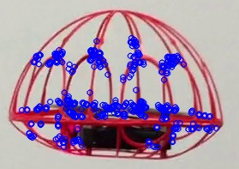
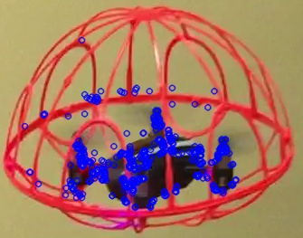
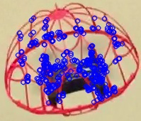
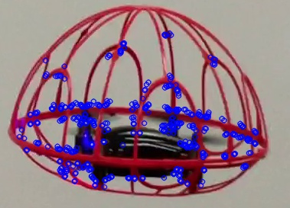
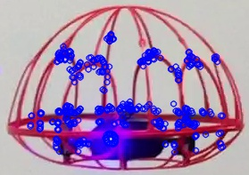
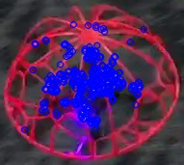
Training
Video collection
Take videos of each UAV
Vary angles and distances
Try to match competition conditions
Data labelling
Frame by frame
Define bounding box around object
Save image and box dimensions
Feature extraction
Find keypoints within bounding boxes
Save descriptors

Slide 34
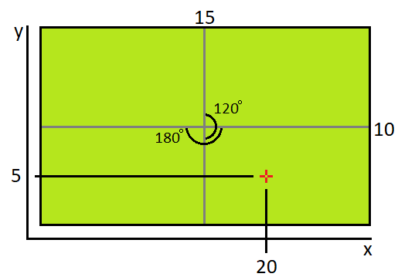
Pursuit Guidance
The eyes of the pursuit is the camera
Determine relative angle of detected object in view
Goal: Keep target in center of view
Reduce error
Example:
Y axis
10 is middle, 20 is the total length
120 degree field of view
Relative angle = 5 - 10 * 120/20 = -30
X axis
15 is middle, length is 30,
180 degree field of view
Relative angle = 20-15 * 180/30 = 30
Notes:
Cut this slide -Sean

Slide 35
GNC
Guidance
Direction, velocity, acceleration
Generate guidance commands
Move towards target/waypoints
Navigation
Localization
Control
Translate guidance commands to mechanical control
Ensure stable flight
Generate motor power commands for each motor

Slide 36
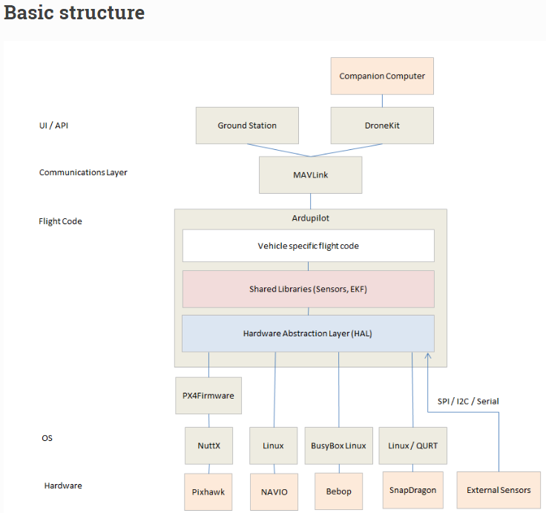

Slide 37
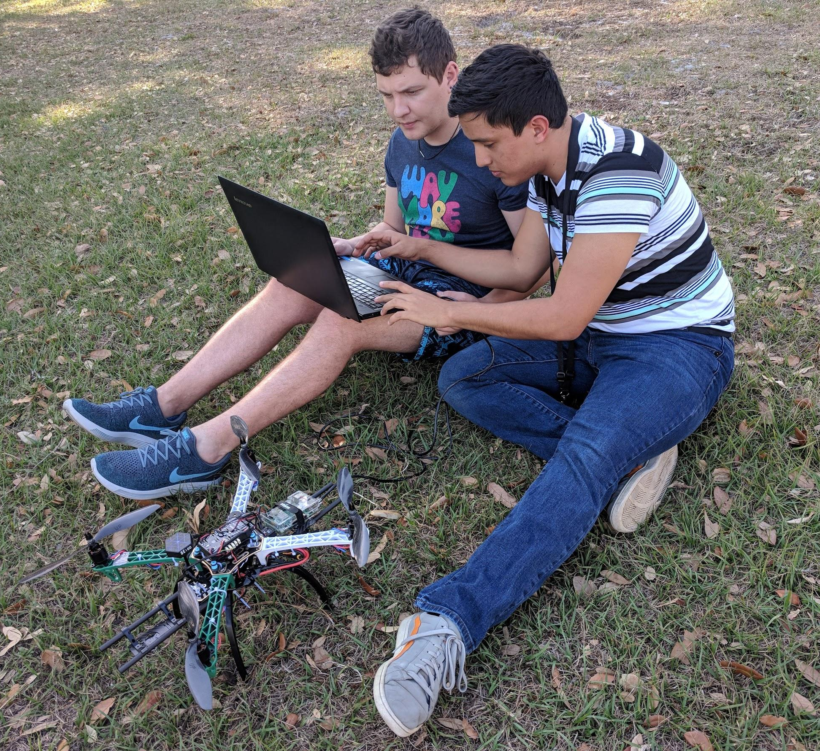
Navigation
Localization: Positioning and Orientation
GPS
Absolute coordinates
Optical flow camera
Aimed downward
Measure x-y movement
Laser rangefinder
Measure altitude

Slide 38
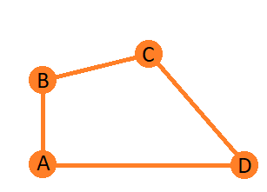
Search
Waypoint navigation
Represent a map as an array, easier use, faster search
Look around when the waypoint is reached

Slide 39
New Search
Pattern
Takeoff
Travel to waypoint
360 degree turn
20 degree turn
2nd waypoint
Repeat waypoints until Pursuit
Suits course better

Slide 41
Simulation and Testing

Slide 42
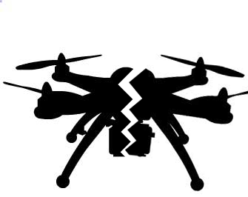
Simulation Motivation
Mitigate risk and damage
Reliably test new code
Test without hardware
Simulate behavior of different components
Simulate unavailable conditions

Slide 43
Simulation
Notes:
This video shows the guidance system working within Gazebo. The drone autonomously arms, performs takeoff and proceeds towards waypoint in search mode. At approximately 45 seconds the drone is manually triggered into pursuit mode to test obstacle avoidance. When the drone closes within 2 meters of an obstacle it is autonomously forced back into search mode. As you can see, the drone continues back to waypoint navigation.

Slide 44
Administrative

Slide 45
Work Distribution
Ley Nezifort
Software Engineer
Julian Quitian
Project Manager
Embedded Systems Engineer
Maverick Dusan
Power & Electronics Engineer
Dominic Williams
Systems Engineer

Slide 46
Main Challenges
Integration
Requirements Changes
Procurement Issues
Testing Constraints
PCB Challenges

Slide 47
Project timeline
FEB 1
FEB 15
MAR 1
MAR 15
APR 1
APR 13
Procurement
Assembly
Flight Testing
System Testing
Presentation Prep
Competition
Submit order forms and acquire parts.
Integrate components.
Conduct flight testing in stages.
Adjust sensor and vision systems to flight readiness.
Work on CDR delivery and competition day.
Win the LM Robocopters Competition!

Slide 48
Final Project/Mass Budget
Area | Component | Mass (lb) | Price ($) | Quantity
Structures | Frame Cage Camera Positioning Kit | 0.7 0.7 0.15 | $18.99 $134.59 $115.95 | 1 1 1
Propulsion | Motors Propeller ESC | 0.17 0.06 0.02 | $124.00 $8.30 $46.99 | 4 4 4
Power | Main Battery Secondary Battery Power Module PDB/PCB | 0.77 0.14 0.04 0.05 | $66.59 $29.96 $8.48 $67.75 | 1 2 1 1
Vision | Camera Gimbal FlowCam Transmitter | 0.07 0.08 0.05 | $74.99 $50.64 $112.35 $145.78 | 1 1 1 1
Avionics | Flight Controller Onboard Computer Microcontroller Sensors Laser Telemetry Kit Receiver | 0.08 0.09 0.06 0.02 0.05 0.06 0.08 | $95.99 $36.46 $16.99 $19.78 $109.95 $36.99 $34.99 | 1 1 1 3 1 1 1
Excess |  | 0.13 | $125.42
Total |  | 4.5 | $1,357.51

Slide 49
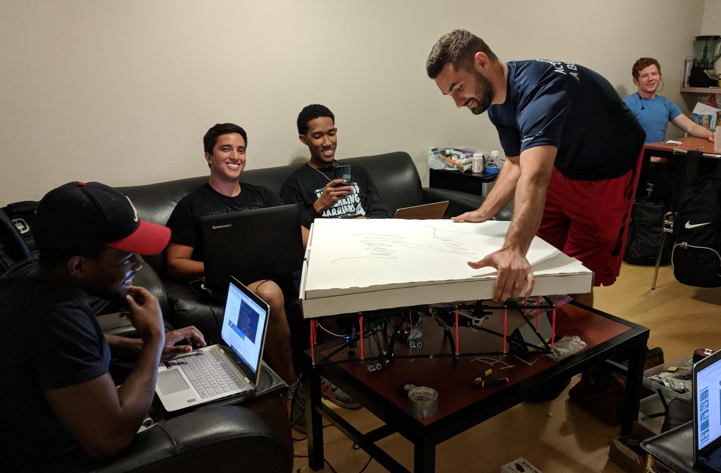
Acknowledgements

Slide 50
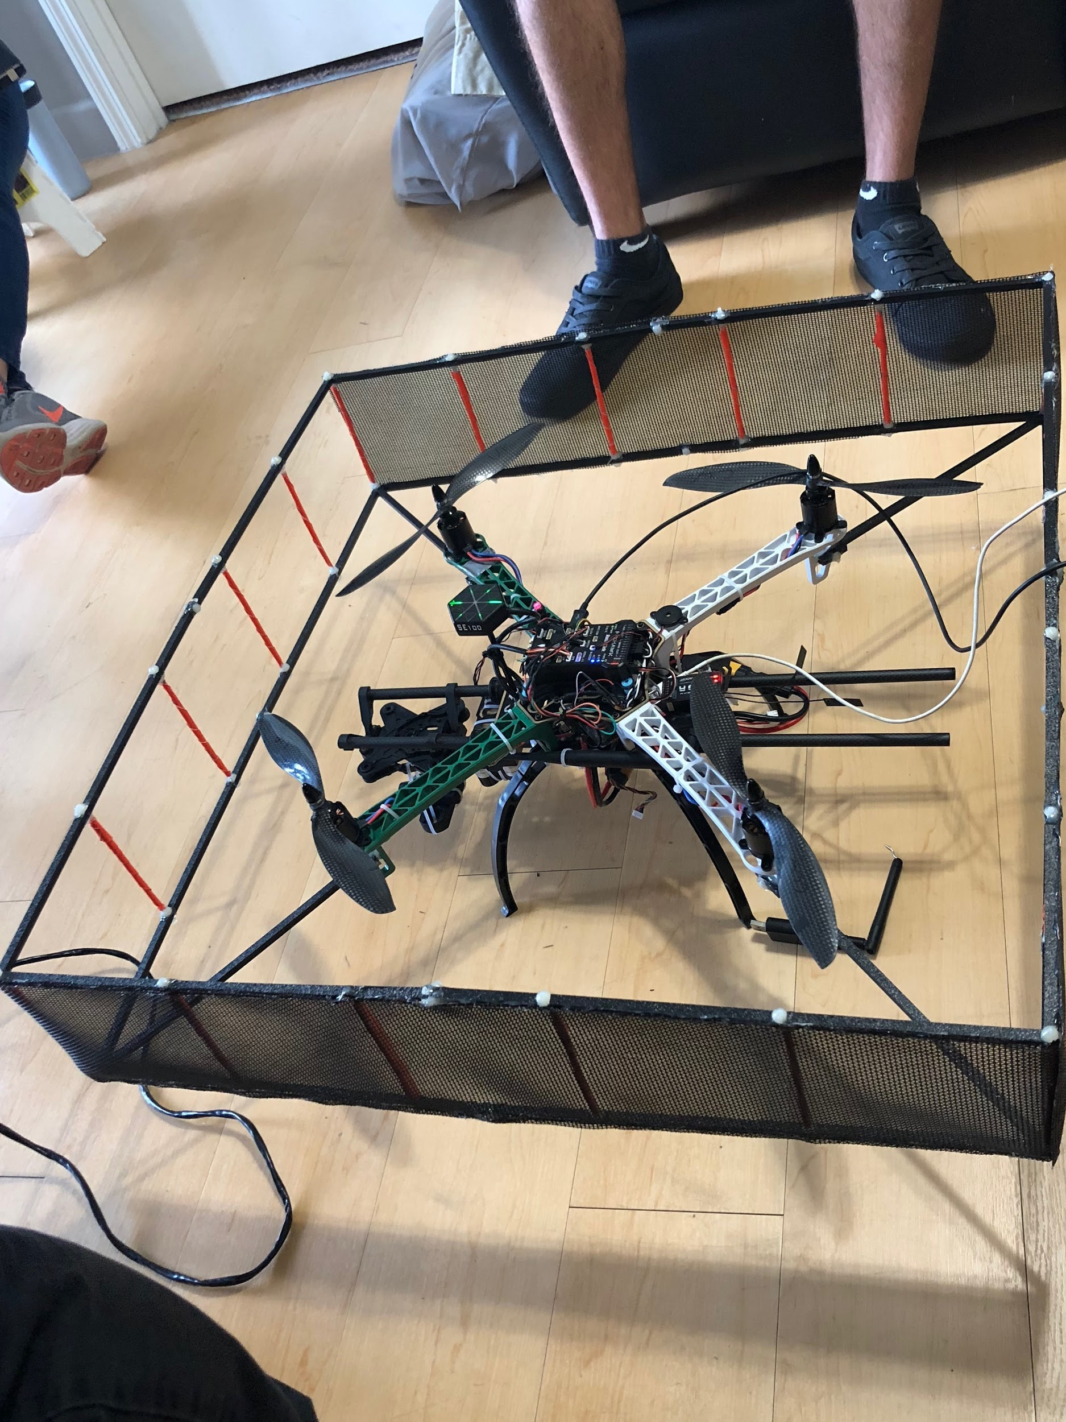
Questions?

